Slide 1
Chapter 1

Slide 2
Objectives

Slide 3
Objectives (continued)

Slide 4
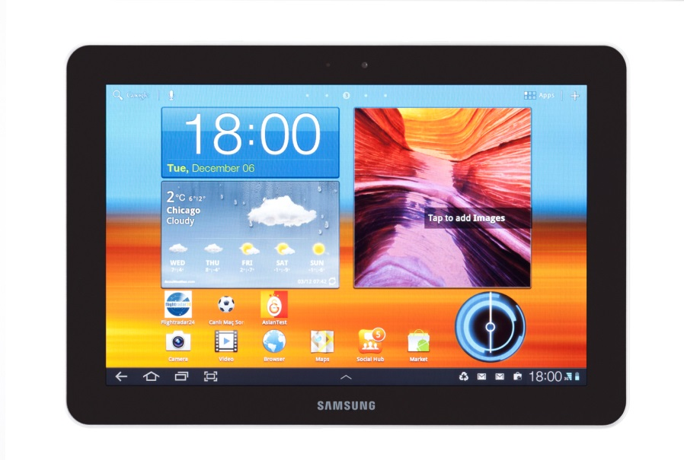
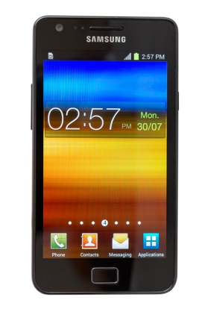
An Android phone and tablet

Slide 5
Other types of Android devices

Slide 6
Types of Android apps

Slide 7
A brief history of Android

Slide 8
Android versions from October 2015

Slide 9
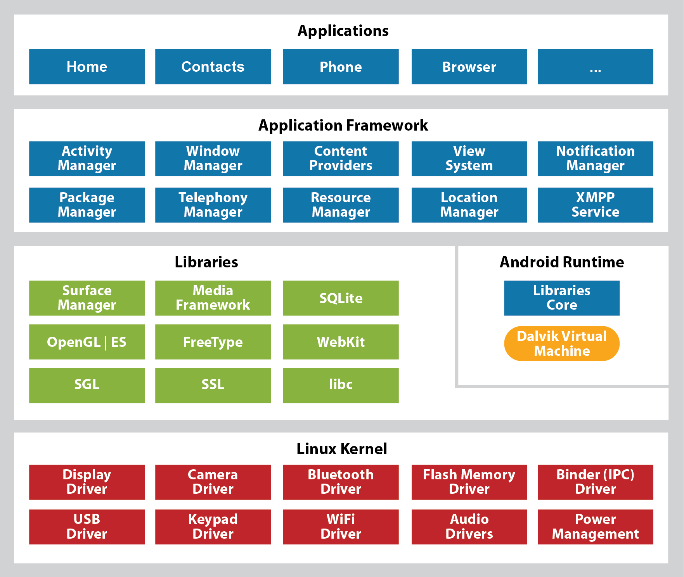
Android stack

Slide 10
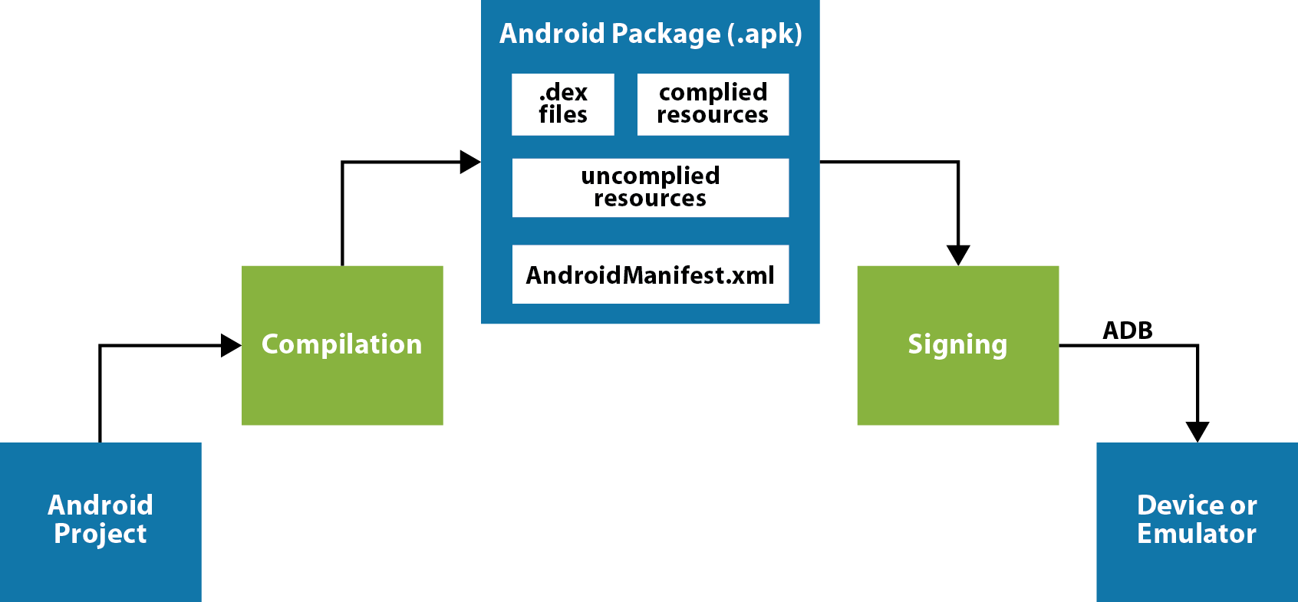
Android system architecture

Slide 11
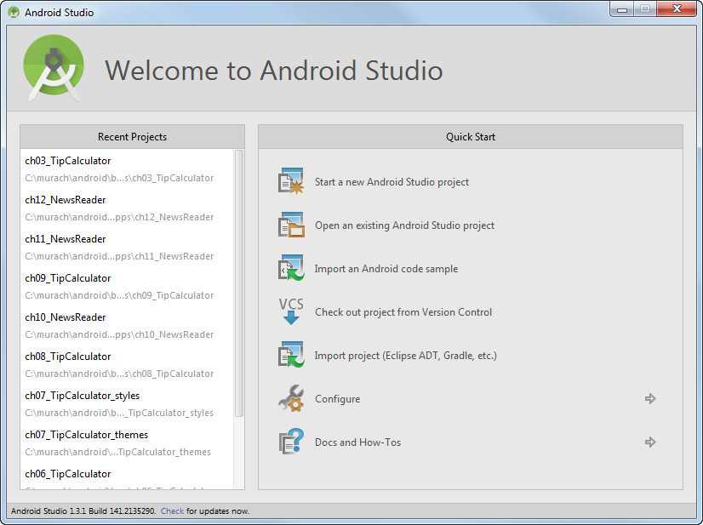
The Welcome page

Slide 12
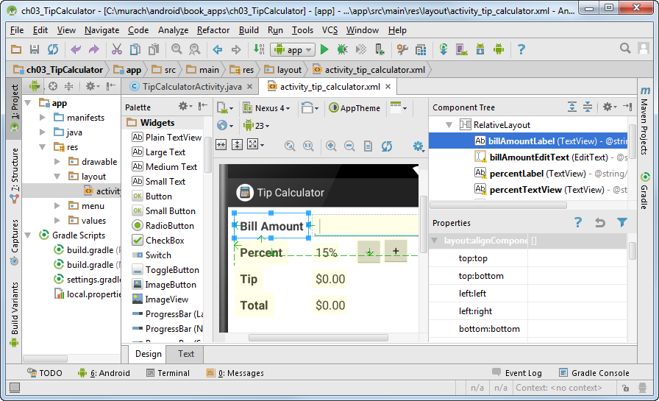
The layout for the Tip Calculator activity in the graphical editor

Slide 13
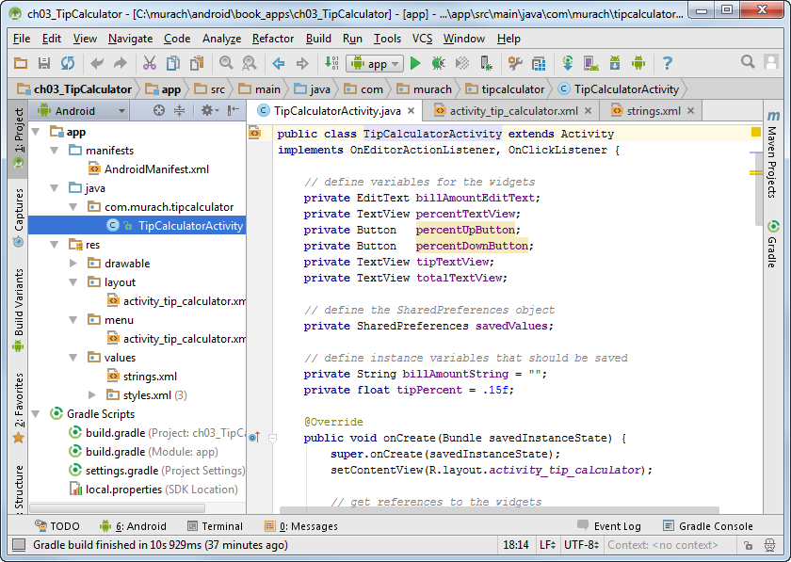
The Java code for the Tip Calculator activity

Slide 14
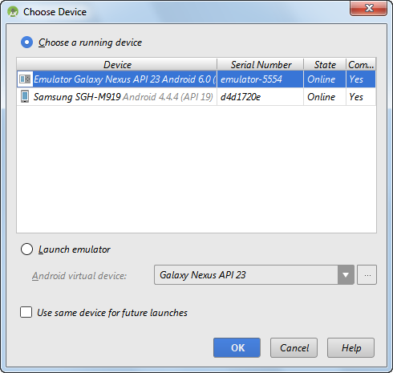
The Choose Device dialog

Slide 15
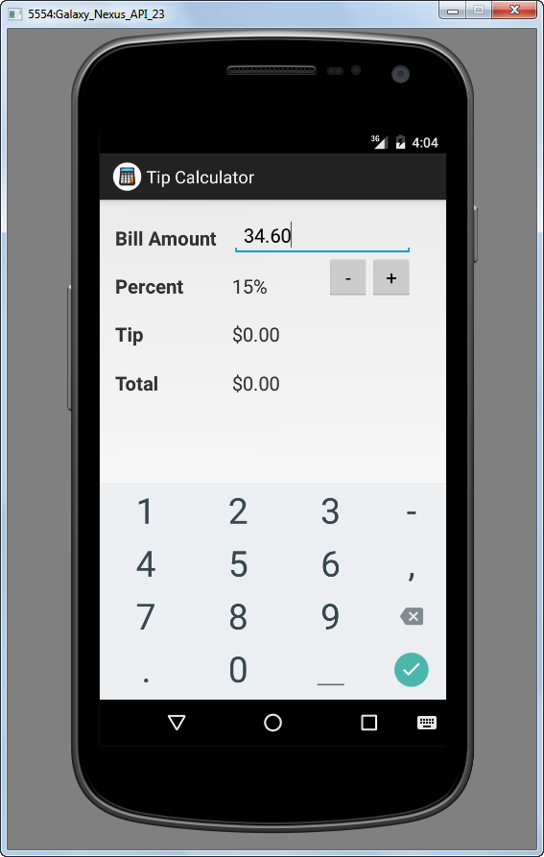
The Tip Calculator app with the soft keyboard displayed

